Slide 1
Introduction to SystemVerilog HDVL
Copyright © 2021 Intel Corporation.
This document is intended for personal use only.
Unauthorized distribution, modification, public performance,
public display, or copying of this material via any medium is strictly prohibited.

Slide 2
Session Topics
Introduction to SystemVerilog (SV)
SystemVerilog data types and operators
Procedural Blocks and Procedural constructs
Enumerated Data types
Implicit .name and .* associations

Slide 3
Key takeaways of the training with hands-on labs
Introduction to the SV Logic data type
Implicit .name and .* associations
Specialized always procedural blocks
Enumerated data types
Constraint random test case generation
Check the functionality of the design using Questa- Intel FPGA starter edition

Slide 4
SystemVerilog
Verilog 1995 version has been in market for a very long time.
IEEE extended the features of Verilog 1995 and released it as Verilog 2001.
Verilog HDL and VHDL are popular design languages used by design engineers for modeling the design and the hardware verification languages (HVL) like specman e and vera used by verification engineers for verifying the design.
It was rather painful to have two languages one for design and the other for verification .
SystemVerilog combines the verification capabilities of HVL with ease of Verilog to provide a single platform for both design and verification.

Slide 5
SystemVerilog
System Verilog is not a new Hardware description Language. SystemVerilog is a rich set of extensions to the existing Verilog HDL.
The primary goal of System Verilog is to enable modeling and verifying large complex designs.
However, SystemVerilog provides enhancements to Verilog that every engineer can and should take advantage of.
SystemVerilog makes it easier to model with Verilog and helps ensure that models will both simulate and synthesize correctly.

Slide 6
SystemVerilog
SystemVerilog, officially the IEEE Std 1800-2005™ standard, is a set of extensions to the IEEE Std 1364-2005™ Verilog Standard (commonly referred to as “Verilog-2005”).
These extensions provide new and powerful language constructs for modeling and verifying the behavior of designs that are ever increasing in size and complexity.
SystemVerilog is the third generation of Verilog [ Verilog 1995, Verilog 2001 and Verilog 2005]
SystemVerilog is the industry’s first Hardware Description and Verification Language (HDVL).

Slide 7
SystemVerilog for design and verification
The SystemVerilog extensions to Verilog can be generalized to two primary categories:
SystemVerilog for design • Enhancements primarily addressing the needs of hardware modeling, both in terms of overall efficiency and abstraction levels.
SystemVerilog for Verification • Verification enhancements and assertions for writing efficient, race-free testbenches for very large, complex designs.

Slide 8
Verilog 1995

Slide 9
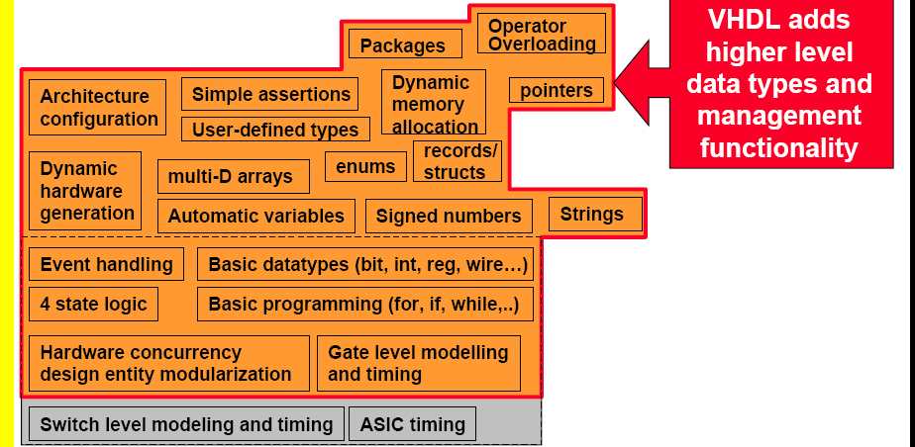
VHDL

Slide 10
C Language

Slide 11
Verilog 2001

Slide 12
SystemVerilog-Enhancements

Slide 13
System Verilog-Unified Language

Slide 14
VHDL and SystemVerilog

Slide 15
SystemVerilog-Axes

Slide 16
Verilog to SystemVerilog

Slide 17
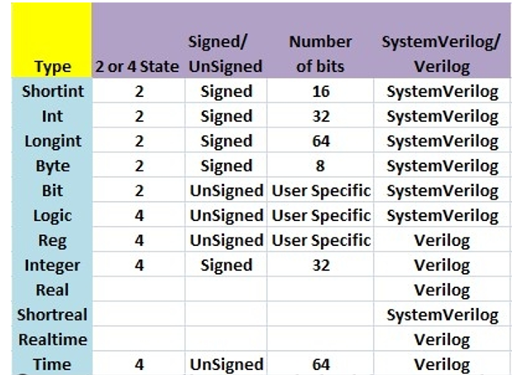
Verilog and SystemVerilog Data Types

Slide 18
Verilog and SystemVerilog Data types
Shortint- 2 state SystemVerilog data type, 16 bit signed.
Int- 2 state SystemVerilog data type 32 bit signed
Long int-2 state SystemVerilog data type 64 bit signed
Byte-2 state SystemVerilog data type , 8-bit signed integer or ASCII character
Bit– 2 state SystemVerilog data type , user defined vector size.
Logic– 4 state SystemVerilog data type , user defined vector size.
Reg- 4 state Verilog 2001 data type , user defined vector size.
Integer- 4 state Verilog 2001 data type, 32-bit signed integer.
Time- 4 state Verilog 2001 data type, 64 bit unsigned

Slide 19
2 state and 4 state types
Types that have unknown and high impedance values are called 4 state types.
These are logic, reg , integer and time.
The other types do not have unknown values and are called 2 state types for example bit and int.
The difference between int and integer is that int is 2 state logic and integer is 4 state logic.
4 state values have additional bits that encode the x and z states.
2 state data types can simulate faster, take less memory and are preferred in some design styles and testbenches.

Slide 20
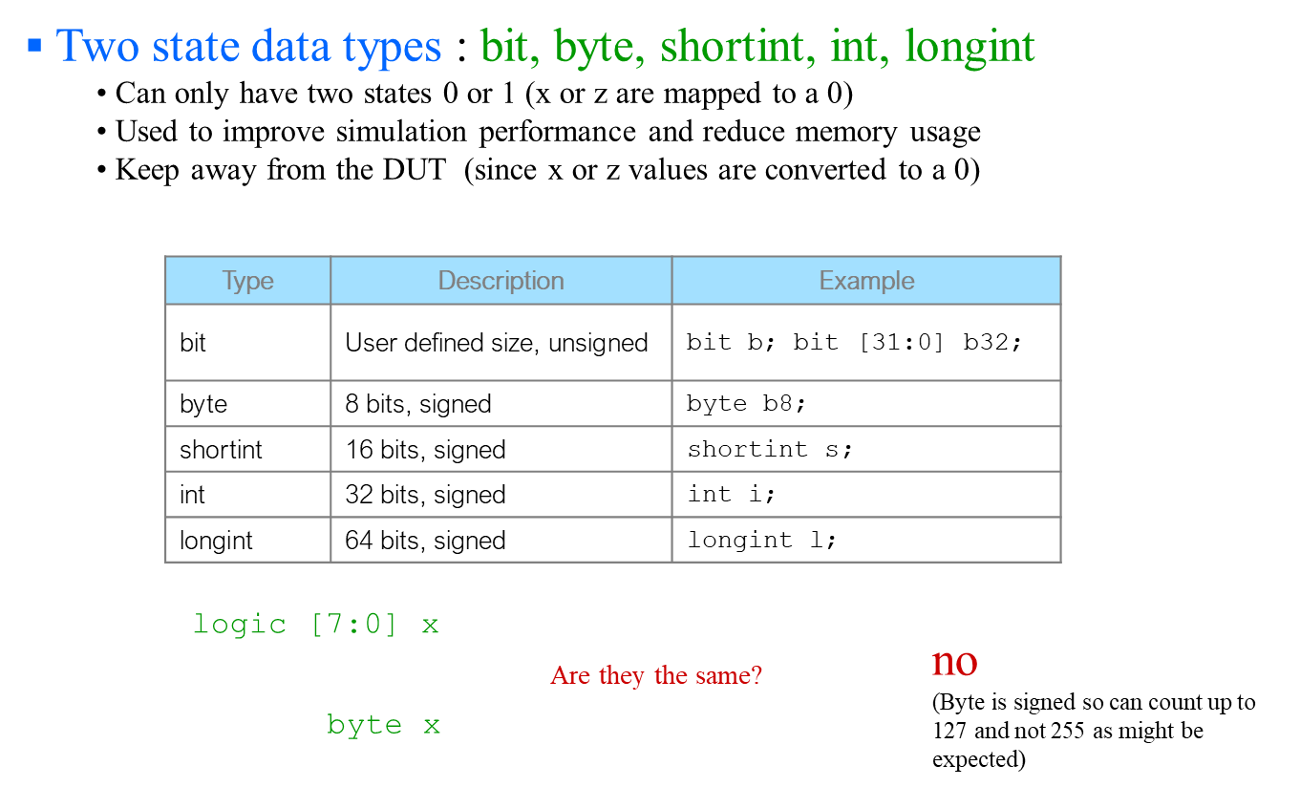

Two state data types

Slide 21
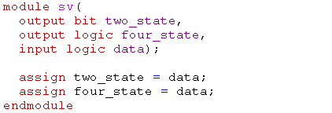
Two state and Four state data types

Slide 22
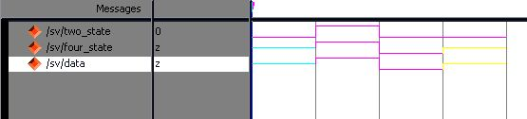
Simulation Result
Initial value of 2-state variable is ‘0’ & it assigns ‘0’ when ever the data is ‘X'
At tri-state 2-state variable assigns ‘0’

Slide 23
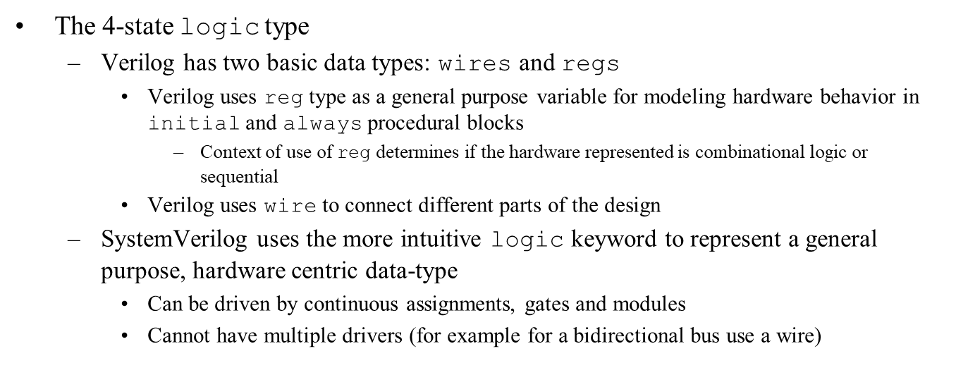
SystemVerilog logic data type

Slide 24
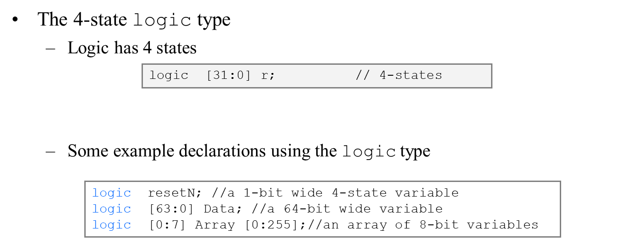
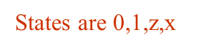
Example declarations of Logic data type

Slide 25
SystemVerilog Logic Data type
Logic data type can be used in all the levels of Modeling.
Data Flow Modeling:
module mux2to1
( input logic a,
input logic b,
input logic sel,
output logic y);
assign y= sel ? b:a;
endmodule

Slide 26
SystemVerilog Logic Data type
module adder
( input logic a,b,
output logic sum,carry);
xor g1 (sum, a,b);
and g2 (carry, a,b);
endmodule
The SystemVerilog logic data type can be used in structural modeling.
The logic data type can be used with built in gate level primitives.

Slide 27
SystemVerilog Logic Data type
module fulladder
( input logic a, b, cin,
output logic sum,carry);
always @( a or b or cin)
begin
sum =a ^b^ cin;
carry =a & b| b& cin| cin & a;
end
endmodule

Slide 28
SystemVerilog Procedural blocks
The Verilog language provides a general-purpose procedural block called always, that is used to model a variety of hardware types as well as verification routines.
Because of the general-purpose application of the always procedural block, the design intent is not readily apparent.
SystemVerilog extends Verilog by adding hardware specific procedural blocks that clearly indicate the designer’s intent.
By reducing the ambiguity of the general purpose always procedural block, simulation, synthesis, formal checkers, lint checkers, and other EDA software tools can perform their tasks with greater accuracy , and with a greater consistency between different tools.

Slide 29
SystemVerilog specialized always blocks
always_comb
always_latch
always_ff

Slide 30
Always Block
Combinational Logic:
The always keyword must be followed by a sensitive event control line.( the @ token).
The sensitivity list of the event control cannot contain posedge or negedge qualifiers.
The sensitivity list should include all inputs to the Procedural block. Inputs are any signal read by the procedural block, where that signal receives its value from outside the procedural block.
The procedural block cannot contain any other event controls.
All variables written to by the procedural block must be updated for all possible input conditions.
Any variables written to by the procedural block cannot be written by another procedural block.

Slide 31
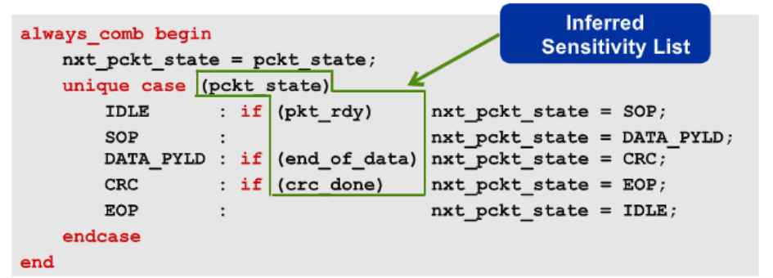
always_comb
Designer’s intent to model combinatorial logic
Sensitivity list is inferred
Outputs cannot be assigned in another block
Evaluated at time zero

Slide 32
Latched Logic – Specialized Always block
Latched Logic:
The always keyword must be followed by a sensitive event control ( i.e. @ token).
The sensitivity list of the event control cannot contain posedge or negedge qualifiers.
The sensitivity list should include all inputs to the procedural block .
Inputs are any signal read by the procedural block, where that signal receives its value from outside the procedural block.
The procedural cannot contain any other event controls.
At least one variable written to by the procedural block must not be updated for some input conditions.
Any variables written to by the procedural block cannot be written to by any other procedural block.

Slide 33

always_latch
Designer’s intent to model latched logic
Sensitivity list is inferred
Outputs cannot be assigned in another block
Evaluated at time zero
Latch inference are discouraged in FPGA based designs

Slide 34
Sequential Logic
The always keyword must be followed by an edge sensitive event control ( i.e. @ token).
All signals in the event control sensitivity must be qualified with posedge or negedge qualifiers.
The procedural block cannot contain any other event controls.
Any variables written to by the procedural block cannot be written to by any other procedural block.

Slide 35
Sequential logic Procedural blocks
always_ff @( posedge clock, negedge resetN)
if( !resetN) q<=0;
else q<=d;
A sensitivity list must be specified with an always_ff procedural block .This allows the engineer to model either synchronous or asynchronous set and/or reset logic , based on the contents of the sensitivity list.
By using always_ff to model sequential logic, software tools do not need to examine the procedural block’s contents to try to infer the type of logic intended.
With the intent clearly indicated by the specialized procedural block type, software tools can instead examine the procedural block’s contents and warn if the contents cannot be synthesized as sequential logic.

Slide 36
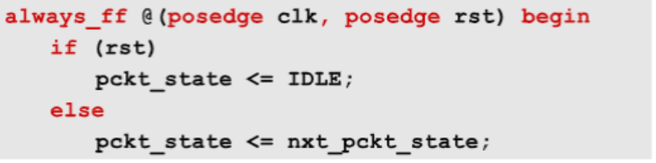
always_ff
Designer’s intent to model sequential logic.
Sensitivity list must be specified
Outputs cannot be assigned in another block

Slide 37
Unique Case
module mux3_1
(input a,b,c,
input [1:0] sel,
output reg y);
always @(*)
begin
unique case (sel)
2’b00: y = a;
2’b01: y = b;
2’b10: y = c;
endcase
end
endmodule

Slide 38
Priority Case
module mux3_1
( input a,b,c,
input [1:0] sel,
output logic y);
always @(*)
begin
priority casez (sel)
2'b0?: y = a;
2'b?1: y = b;
2'b1?: y = c;
endcase
end
endmodule

Slide 39
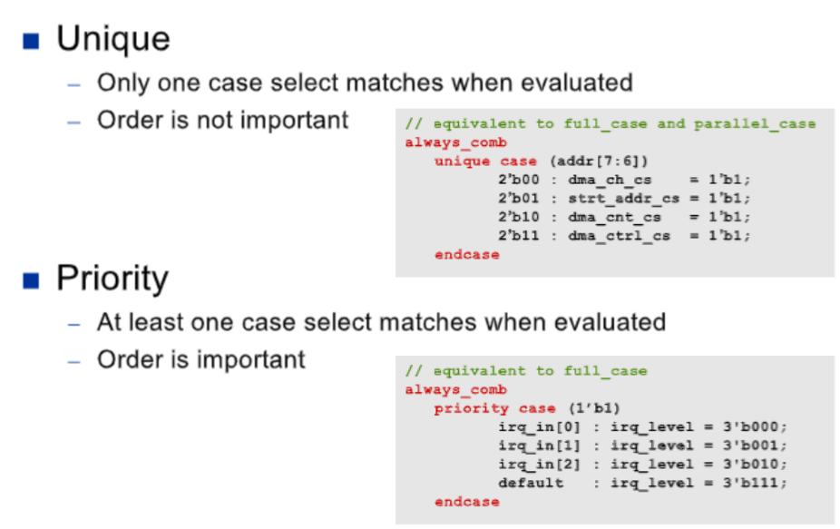
Enhanced Case statements

Slide 40
SystemVerilog Enumerated Data Types
Enumerated data types allow to implement an FSM design without thinking about the the actual state encodings that will be used in the design.
SystemVerilog enumerated types then permit useful assignment of values to the enumerated names to apply designer requirements to the FSM designs.
Enumerated data types can be declared without assigned values.
SystemVerilog enumerated type declarations can also be updated to use user defined values.

Slide 41
FSM with Enumerated Data types
module fsm
( input x, clk, rst ,
output y);
enum { SET0=1,HOLD0=2,SET1=4,HOLD1=8}current_state,next_state;
always_ff@ (posedge clk or posedge rst)
begin:SEQ_BLOCK
if(rst)
current_state <= set0;
else
current_state<= next_state;
end: SEQ_BLOCK

Slide 42
FSM with Enumerated Data types
always_comb
case (current_state)
SET0: next_state=HOLD0;
HOLD0: if(x==0) next_state =HOLD0;
else next_state= SET1;
SET1:next_state= HOLD1;
HOLD1:next_state =SET0;
default:next_state=SET0;
endcase
assign y= current_state== HOLD0 & x;
endmodule

Slide 43
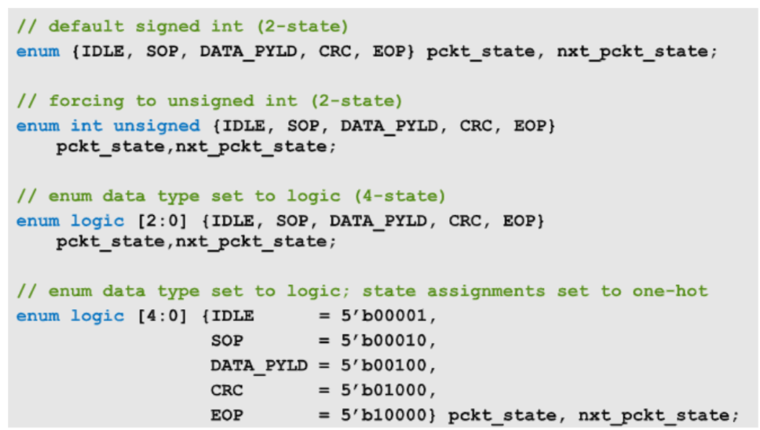
State Encoding with Enumerated data types

Slide 44
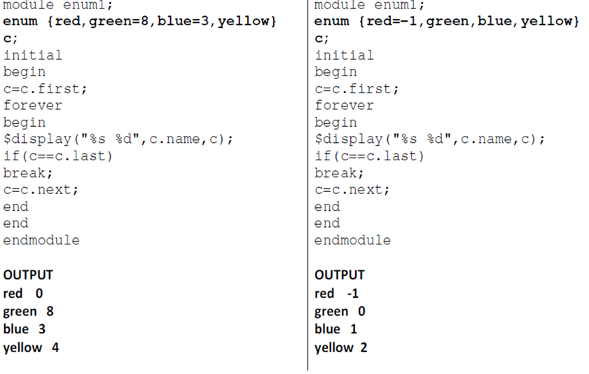
Enumerated Data types

Slide 45
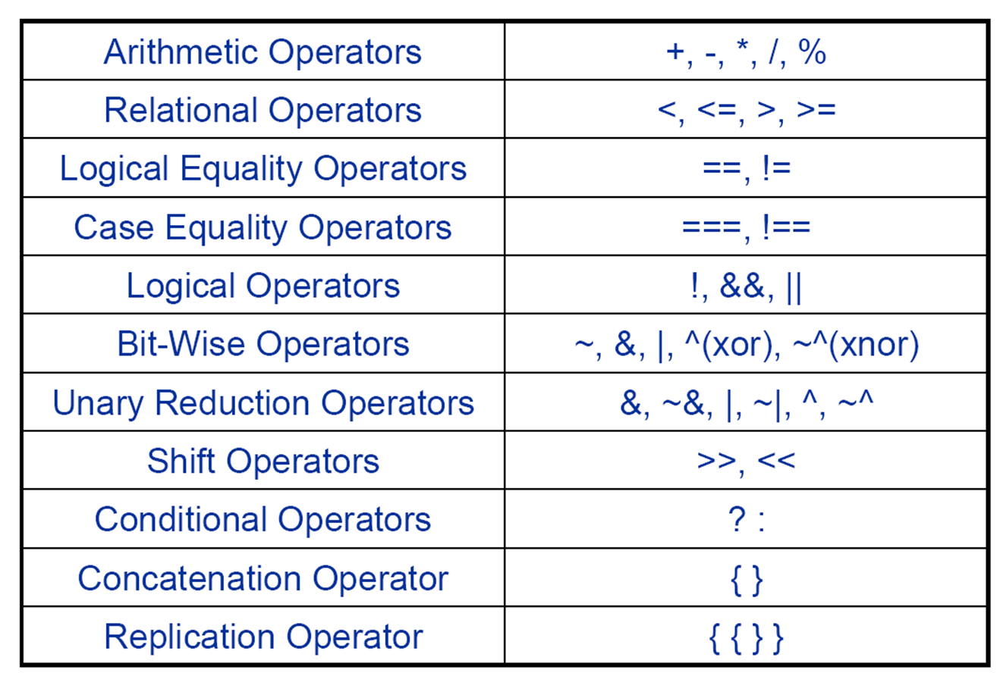
Revisit: Verilog Operators

Slide 46
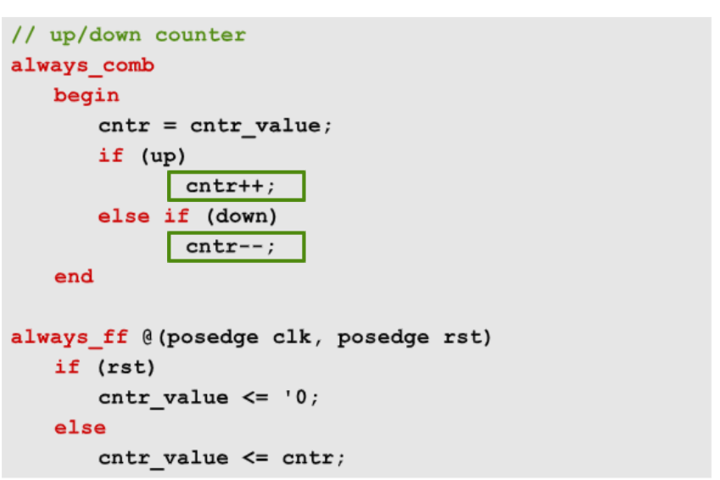
SV Increment and Decrement Operators

Slide 47
Assignment Operators
In addition to the simple assignment operators = , SystemVerilog includes the C assignment operators and special bit wise assignment operators.
+=,-=,*=, /=,%=, &=, |=,^=,<<=,>>=,<<<= and >>>=
An assignment operator is semantically equivalent to a blocking assignment, with the exception that any left-hand side index expression is only evaluated once.
For ex:
a[i] +=2;
same as a[i] = a[i] +2
In SystemVerilog, an expression can include a blocking assignment provided it does not have a timing control.

Slide 48
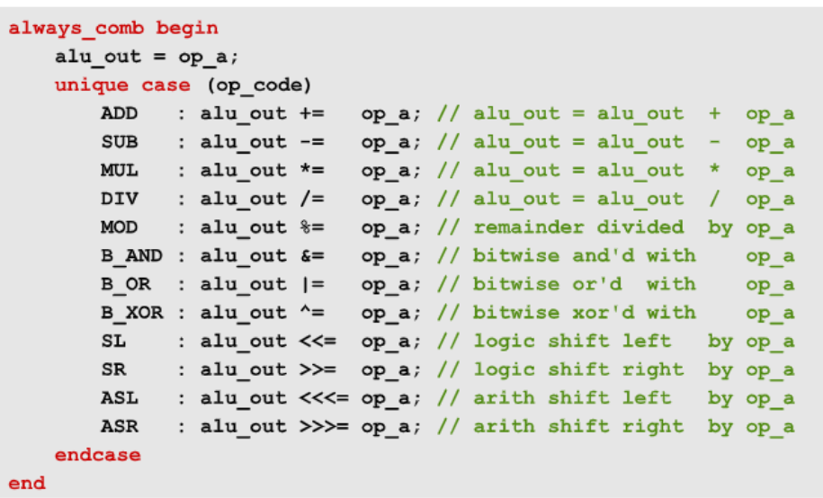
SystemVerilog Assignment Operators

Slide 49
Guidelines for using ++ and -- operators
To prevent potential race conditions, the increment and decrement operators should only be used to model combinational logic.
Sequential and Latched Logic Procedural blocks should not use the increment and decrement operators to modify any variables that are to be read outside of procedural block.

Slide 50
Synthesis Guidelines
The ++ and – operators behave as blocking assignments.
Both the pre and post forms of increment and decrement operators are synthesizable.
However, some synthesis compilers only support increment and decrement operations when used as a separate statement.
i++ ---- Synthesizable
if(--i) ---- Not synthesizable
sum=i++ --- Not synthesizable

Slide 51
Synthesis Guidelines
Assignment Operators
b+=5 --- Synthesizable
b= (a+=5) --- Not Synthesizable
The assignment operators are synthesizable, but synthesis compilers may place restrictions on multiply and divide operations.
Some compilers do not support the use of assignment operators in compound expressions.

Slide 52
Wild card equality and Inequality Operators
The logical equality operators (== and !=) may result in X if any of their operands contains an X or Z. The case equality operators (=== and !==) explicitly check for 4-state values; therefore, X and Z values shall either match or mismatch, never resulting in X. The wildcard equality operators (==? and !=?) may result in X if the left operand contains an X or Z that is not being compared with a wildcard in the right operand.

Slide 53
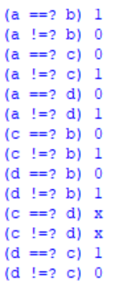
Wild card equality and Inequality Operators

Slide 54
Module Port Connections
Verilog Module Port Connections
Ordered Port Connections/ Positional Port Connections
Named Port Connections
SystemVerilog Module Port Connections
Implicit . name connections
Implicit .* connections

Slide 55
Verilog positional port connections
Both Verilog 1995 and Verilog 2001 permit module instantiation using positional port connections.
Instantiation using positional ports simply requires listing the port connections in the correct order to match the port order of the instantiated module.
Advantage: Instantiation of a module is fast and easy.
Disadvantage: If the module is instantiated with an incorrect port order, the simulation will fail and the task of debugging this type of bug can be time consuming.
If the port order of the instantiated module is changed by a third party, the instantiation will also have to change.

Slide 56
Verilog positional port connections
Minor port changes are often the most difficult to find and debug. Swapping two control signal inputs will still compile without syntax error and there will be no compilation warning.
Finding this type of bug can be very time consuming.
Guideline: When instantiating a module from another design team member, from a third party or vendor, or if you do not have direct control over the module being instantiated, do not use positional port connections.
Reason: If the author of the module decides that the port order should be changed to “make the design readable”, all instantiations of the module will have to be updated.
This is a common guideline at many companies.

Slide 57
Verilog named port connections
Both Verilog 1995 and Verilog 2001 permit module instantiation using named port connections.
Instantiation using named ports simply requires listing both the explicit port names of the module being instantiated and the accompanying net names that connect the explicit ports.
Disadvantage: Instantiations are twice as verbose as using positional port connections and take longer to build.
Advantages: The ordering of the instance ports does not cause design failures.
If the port order of the instantiated module is changed by a third party, no instantiation changes are required.

Slide 58
Verilog named port connections
Minor port changes do not impact a design.
If the port names change, the compiler gives immediate feedback, in the form of a syntax error, indicating that the specified ports do not exist.
Guideline: In general, use named port connections when instantiating modules in a design.
Guideline: Show all unconnected module ports using empty named connections.
Reason: Some Verilog compilers give warnings for missing ports from a named port connection list.
Unnecessary warnings should be avoided.

Slide 59
SystemVerilog .name Port connections
SystemVerilog permits an abbreviated method to instantiate modules using the implicit .name port connection enhancement.
In SystemVerilog, if the net connected to a port of an instantiated model matches the name of the port on the instantiated model, the size of the port on the instantiated model and has a compatible data type to the port on the instantiated model, the matching port name can be listed just once with a leading period.
This is the same syntax as named port connections only without the redundant name inside of parentheses.

Slide 60
SystemVerilog :Implicit .*port connections
SystemVerilog permits an enhanced and abbreviated method to instantiate modules using the implicit .* port connection token.
In system verilog, if the net connected to a port of an instantiated model matches the name of the port on the instantiated model, the size of the port on the instantiated model and has a compatible data type to the port on the instantiated model, the matching port name can be omitted, and an implicit .* port connection can be made.
SystemVerilog introduces the capability to instantiate modules with highly abbreviated and efficient .* implicit port connections.

Slide 61
Complex ALU Example for SV associations

Slide 62
Verilog 2001 named port connections

Slide 63
Verilog 2001 named port connections

Slide 64
SystemVerilog .name port connections

Slide 65
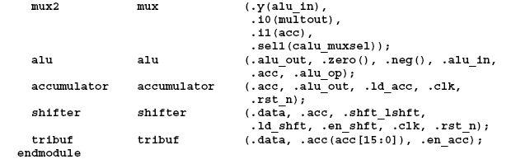
System Verilog .name port connections

Slide 66
SystemVerilog .* port connections

Slide 67
Guidelines
Guideline 1: When instantiating a module from another design team member, from a third party or vendor , or if you do not have direct control over the module being instantiated , do not use positional port connections.
Guideline 2: In general ,use named port connections, when instantiating modules into a design.
Guideline 3:Show all unconnected module ports using empty named connections.
SystemVerilog offers greater abstraction and design brevity through the use of implicit port connections and interfaces.

Slide 68
Verilog Implementation
module fulladder
( input a,b,cin,
output cout,sum);
wire w1 ,w2,w3;
halfadder m1( .a(a),.b(b), .sum(w1), .carry(w2));
halfadder m2 (.a(cin), .b(w1), .sum(sum), .carry(w3));
or (cout, w2, w3);
endmodule

Slide 69
SystemVerilog Implementation
module fulladder
( input logic a,b,cin,
output cout ,sum);
wire w1,w2,w3;
halfadder m1( .a, .b, .sum(w1), .carry(w2));
halfadder m2 (.a(cin), .b(w1), .sum, .carry(w3));
or (cout, w2,w3);
endmodule

Slide 70
Verilog implementation
module fullsubtractor
( input a, b, bi,
Output diff, borr);
wire w1, w2, w3;
half_sub m1 ( .a(a), .b(b), .diff(w2), .borr(w3));
half_sub m2 (.a(w2), .b(bi), .diff(diff), .borr(w1));
or ( borr, w3, w1);
endmodule

Slide 71
SystemVerilog Implementation
module full_sub
( input logic a, b, bi,
output diff, borr);
wire w1, w2, w3;
half_sub m1( .a, .b, .diff(w2), .borr(w3));
half_sub m2 ( .a(w2), .b(bi), .diff, .borr(w1));
or ( borr, w3, w1);
endmodule

Slide 72
SV Constraint Random Testcase Generation
Simple Adder Design
module adder_urand(input logic [15:0]a,b,
output logic [16:0]sum);
assign sum = a + b; endmodule

Slide 73
SV Constraint Random Testcase Generation
module adder_urand_tb; logic [15:0]a,b; logic [16:0]sum; adder_urand a1(.*); initial begin repeat(10) begin a = $urandom_range(50,100); b = $urandom_range(75,100); #10 $display("a=%d ,b=%d ,sum=%d",a,b,sum); end end endmodule

Slide 74
Looping Constructs
Verilog provides for, while, repeat and forever loops .
SystemVerilog enhances the Verilog for loop and adds a do-while loop and a for-each loop.
do while construct is similar to C.
SystemVerilog adds the ability to declare the for-loop control variable within the for loop.
The foreach construct specifies iteration over the elements of an array.

Slide 75
Do while statement
With the do while loop in SystemVerilog, the control for the loop is tested at the end of each pass of the loop , instead of the beginning.
This means that each time the loop is encountered in the execution flow , the loop statements will be executed atleast once.
The basic syntax of a do while loop is given by do < statement or statement block>
while (<condition>);
If the do portion of the loop contains more than one statement, the statements must be grouped using begin..end or fork..join.

Slide 76
Do while Construct
module while_loop ();
byte a = 0;
initial
begin
do
begin
$display ("Current value of a = %d", a);
a ++;
end
while (a < 10);
end
endmodule

Slide 77
Enhanced for loop
module for_loop ();
initial
begin
fork
for (int i = 0 ; i < 4; i ++)
begin
#1 $display ("First -> Current value of i = %d", i);
end
for (int i = 4 ; i > 0; i --)
begin
#1 $display ("Second -> Current value of i = %d", i);
end
join
#1 $finish;
end
endmodule

Slide 78
Simulator output for enhanced for loop
First -> Current value of i = 0
Second -> Current value of i = 4
First -> Current value of i = 1
Second -> Current value of i = 3
First -> Current value of i = 2
Second -> Current value of i = 2
First -> Current value of i = 3
Second -> Current value of i = 1
System Verilog simplifies declaring local variables for use in for loops.
With SystemVerilog, the declaration of the for-loop variable can be made within the for loop itself.

Slide 79
Multiple for loop assignments
System Verilog also enhances Verilog for loops by allowing more than one initial assignment statement , and more than one step assignment statement.
Multiple initial or step assignments are separated by commas: for example
for ( int i =1 , j=0; i* j < 128; i++, j+=3)
Each loop variable can be declared as a different type.
for ( int i=1,byte j=0; i * j< 128; i++, j+=3)
System Verilog’s enhanced for loops are synthesizable , following the same synthesis coding guidelines as Verilog for loops.

Slide 80
Break loop
module break_loop ();
initial
begin
for (int i = 0 ; i < 10; i++)
begin
#1 $display ("Current value of i = %d", i);
if ( i == 5)
begin
$display ("Coming out of for loop");
break;
end
end
end
endmodule

Slide 81
Continue loop
module continue_loop ();
initial
begin
for (int i = 0 ; i < 10; i ++)
begin
if ( (i >= 5) && (i < 8))
begin
$display ("Continue with next interation");
continue;
end
#1 $display ("Current value of i = %d", i);
end
end
endmodule

Slide 82
Simulator output for continue
Current value of i = 0
Current value of i = 1
Current value of i = 2
Current value of i = 3
Current value of i = 4
Continue with next interation
Continue with next interation
Continue with next interation
Current value of i = 8
Current value of i = 9

Slide 83
Arrays
An array is a collection of variables all of the same type and accessed using the same name plus one or more indices.
In C , arrays are indexed from 0 as integers , or converted to pointers. Although the array can be initialized each element must be read or written separately in procedural statements.
In Verilog 2001 arrays are indexed from left-bound to right-bound. If they are vectors , they can be assigned as a single unit, but not if they are arrays. Verilog 2001 allows multiple dimensions.

Slide 84
Arrays
In Verilog 2001all data types can be declared as arrays. The reg, wire and all other net types can also have a vector width declared.
A dimension declared before the object name is referred to as “vector width” dimension. The dimensions declared after the object name are referred to as the array dimensions.

Slide 85
Arrays
SystemVerilog substantiates a programmer by providing many data structures for storing a group of objects ,such as Arrays and Queues.
An array is a non-variable size collection of same type of variables.
A queue is a variable size ordered collection of homogeneous objects.
There are one dimensional and multidimensional arrays of variables.
System Verilog classifies an array into :
(i) Packed array
(ii)Unpacked array

Slide 86
Packed and Unpacked arrays
Packed array: The upper and lower bounds of an array are declared in between the variable type and the variable name.
SystemVerilog uses the term Packed array to refer to the dimensions declared before the object name (what Verilog 2001 refers to as the vector width).
The term unpacked array refers to the dimensions declared after the object name.
Packed arrays can only be made of the single bit types (bit, logic, reg , wire and the other net types) and recursively other packed arrays and packed structures.
The maximum size of a packed array can be limited but shall be at least 65536 bits.

Slide 87
Packed and Unpacked arrays
module packed_unpacked_data();
bit [7:0] packed_array = 8'hCC;
reg unpacked_array [7:0] = `{0,0,0,0,0,0,0,1};
initial
begin
$display ("packed array[0] = %b", packed_array[0]);
$display ("unpacked array[0] = %b", unpacked_array[0]);
$display ("packed array = %b", packed_array);
//$display("unpacked array = %b", unpacked_array);
modify %b to %p and observe the outputs
end
endmodule

Slide 88
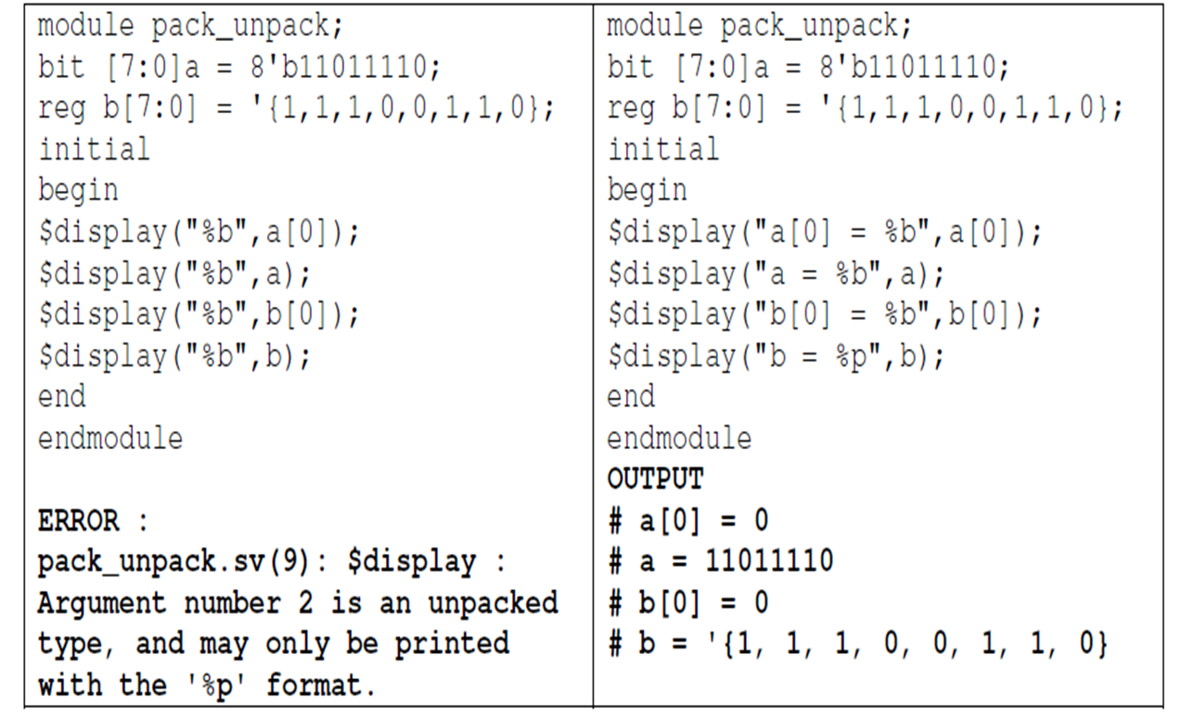
SystemVerilog Packed and Unpacked Arrays

Slide 89
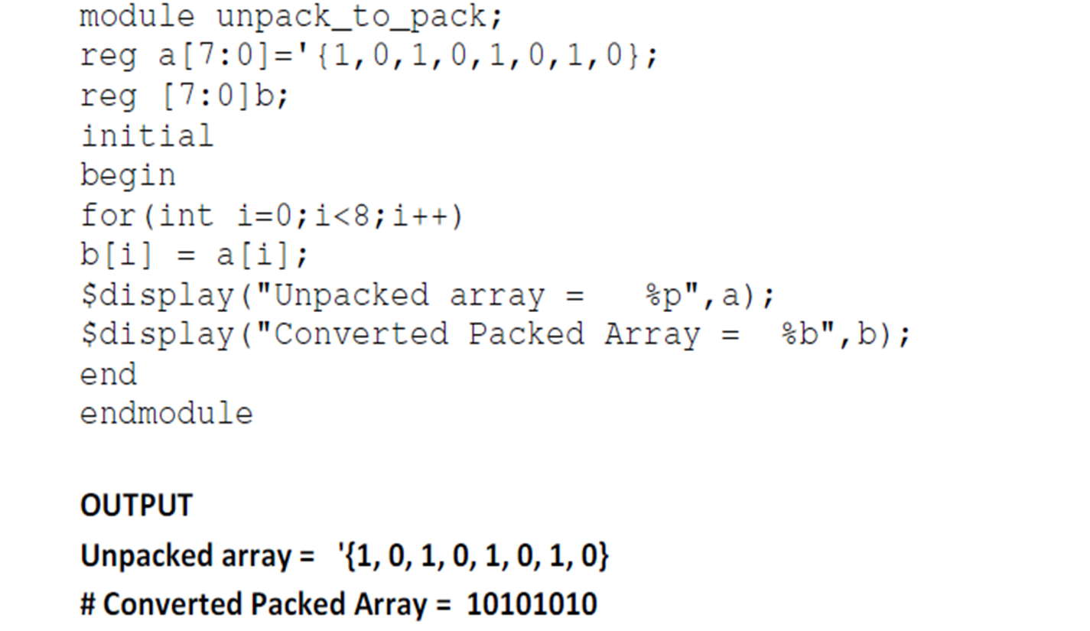
Unpacked Array to Packed Array

Slide 90
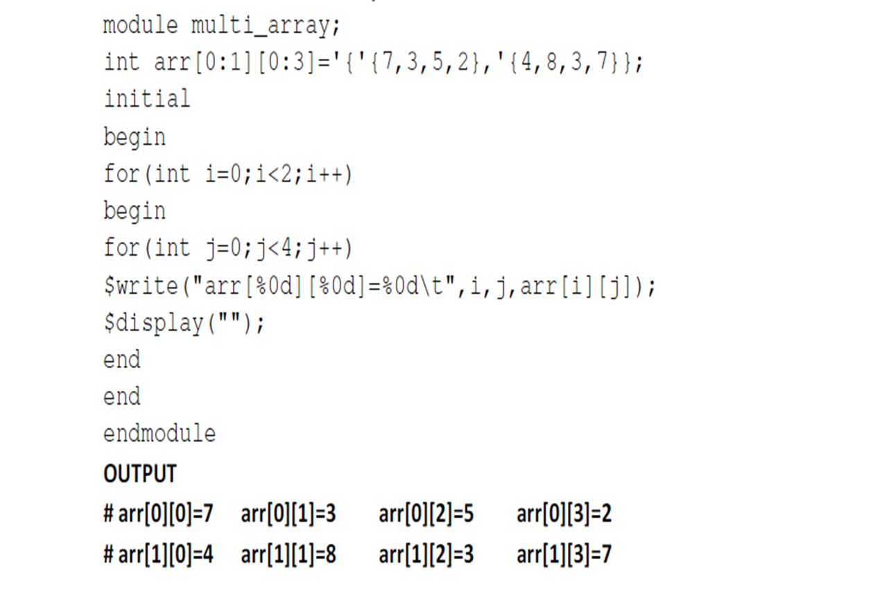
Multi-dimensional Arrays

Slide 91
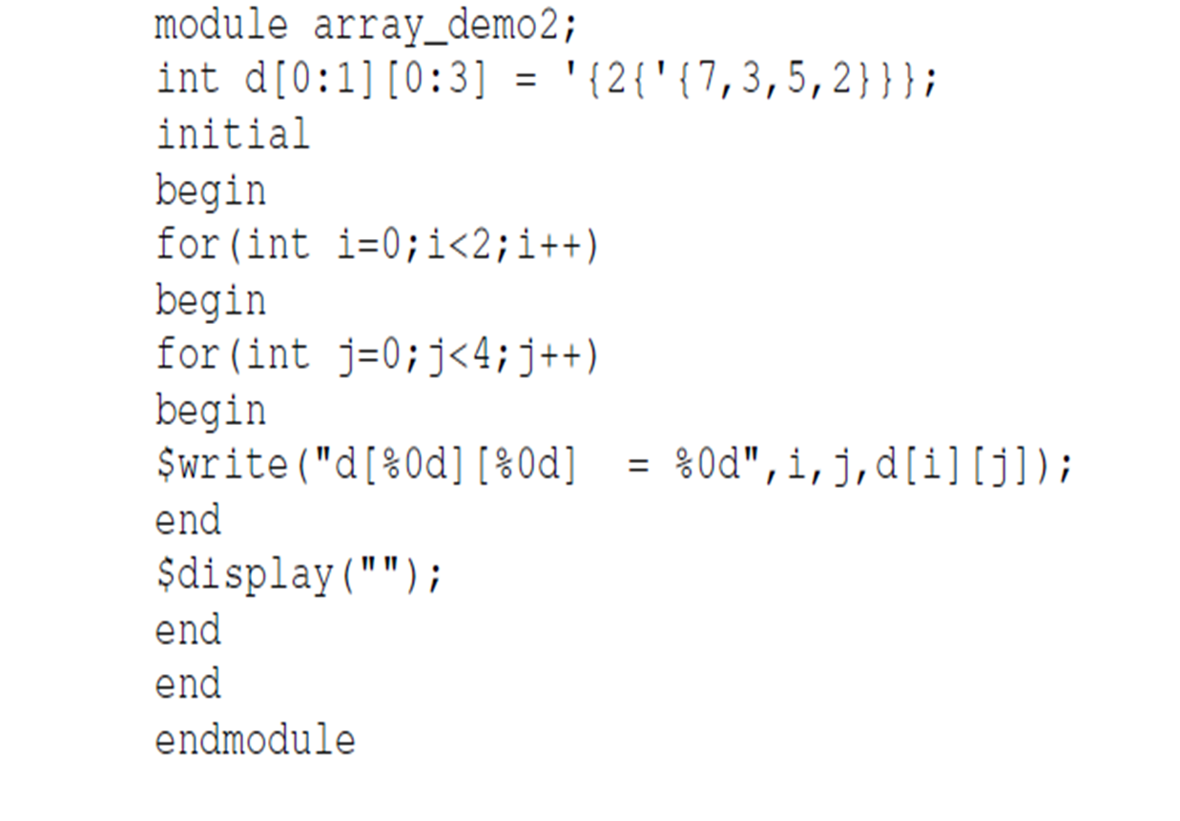
Array Replication

Slide 92
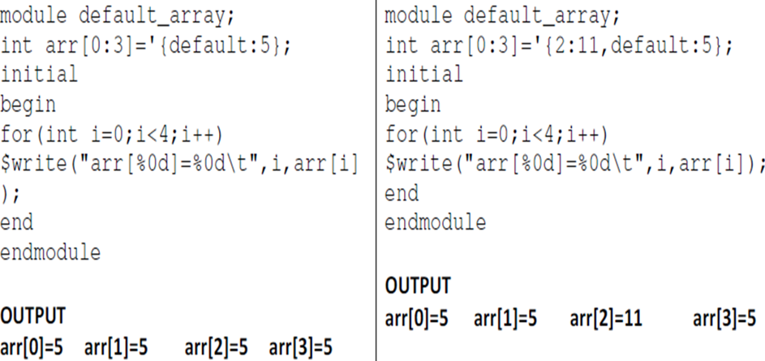
Array with default values

Slide 93
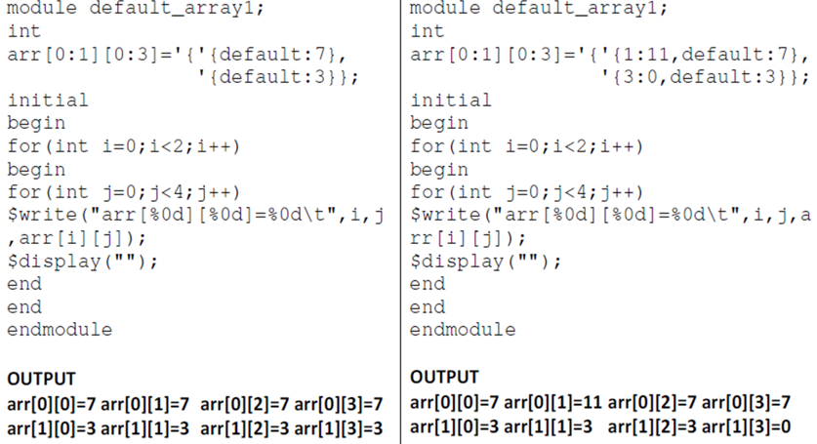

Array with default values

Slide 94
The foreach loop
module foreach_loop ();
byte a [10] = '{0,6,7,4,5,66,77,99,22,11};
initial
begin
foreach (a[i])
begin
$display ("Value of a is %d",i);
end
end
endmodule

Slide 95
System Verilog Type casting
SystemVerilog extends Verilog automatic conversion with a type cast operator.
Type casting allows the designer to specify that a conversion should occur at any point during the evaluation of an expression , instead of just as part of an assignment.
The syntax of type casting is
type `( expression)
This syntax is different from C which uses the format (type) expression.
The different syntax is necessary to maintain backward compatibility with how verilog uses parentheses and to provide additional casting capabilities not in C.

Slide 96
SystemVerilog Type casting
Verilog representation:
reg [63:0] a, y ,temp;
real r;
temp= r ** 3; // convert result to 64-bit integer
y= a + temp;
SystemVerilog representation:
longint a, y;
real r;
y= a + longint `( r ** 3)
Using SystemVerilog types and type casting , the Verilog example can be coded without the use of a temporary variable.

Slide 97
References
SystemVerilog for design – Stuart Sutherland
SystemVerilog 3.1a Language Reference Manual
http://www.sunburst-design.com/papers/

Slide 98
Legal Disclaimers/Acknowledgements
Intel technologies may require enabled hardware, software or service activation
No product or component can be absolutely secure
Your costs and results may vary
Intel, the Intel logo, and other Intel marks are trademarks of Intel Corporation or its subsidiaries. Other names and brands may be claimed as the property of others
OpenCL and the OpenCL logo are trademarks of Apple Inc. used by permission by Khronos
*Other names and brands may be claimed as the property of others

Slide 99
Legal Disclaimers/Acknowledgements
If the presentation includes any performance claims, use this slide instead of slide 10 (and remove this box). Also, follow steps 2-5 on https://legal.intel.com/Marketing/Pages/Notices%20and%20Disclaimers.aspx.
Software and workloads used in performance tests may have been optimized for performance only on Intel microprocessors.
Performance tests, such as SYSmark and MobileMark, are measured using specific computer systems, components, software, operations and functions. Any change to any of those factors may cause the results to vary. You should consult other information and performance tests to assist you in fully evaluating your contemplated purchases, including the performance of that product when combined with other products. For more complete information visit www.intel.com/benchmarks.
Performance results are based on testing as of dates shown in configurations and may not reflect all publicly available ​updates. See backup for configuration details. No product or component can be absolutely secure.
Your costs and results may vary.
Intel technologies may require enabled hardware, software or service activation
No product or component can be absolutely secure
Your costs and results may vary
Intel, the Intel logo, and other Intel marks are trademarks of Intel Corporation or its subsidiaries. Other names and brands may be claimed as the property of others
OpenCL and the OpenCL logo are trademarks of Apple Inc. used by permission by Khronos
*Other names and brands may be claimed as the property of others

Slide 100
Copyright © 2021 Intel Corporation. This document is intended for personal use only. Unauthorized distribution, modification, public performance, public display, or copying of this material via any medium is strictly prohibited.

